Slide 1
RSMamba: Remote Sensing Image Classification with State Space Model
Keyan Chen, Bowen Chen, Chenyang Liu, Wenyuan Li, Zhengxia Zou, and Zhenwei Shi.
Presented by Ritesh Chowdhry and Satya Krishna

Slide 2
Timeline
Structured State Spaces for Sequences (S4) (2020-2022)
Mamba (2024):
~1900s
General State Space Models (SSM)
Kalman Filters (1960)
Hidden Markov Models
Markov Decision Processes
Assumes LTI Systems
Can be implemented in Neural Network Archs.
Hardware Aware Algorithm. Using SRAM and DRAM of GPU carefully.
Vision SSM
So far, these models were applied to sequence tasks.
Uses Linear State-Space Layer (LSSL) [3], HiPPO [2]
S4 Models are LTI, cannot perform content-aware reasoning (language tasks)
Many different implementations exist, using S4 and Mamba.
E.g. VisionMamba, VMamba

Slide 3
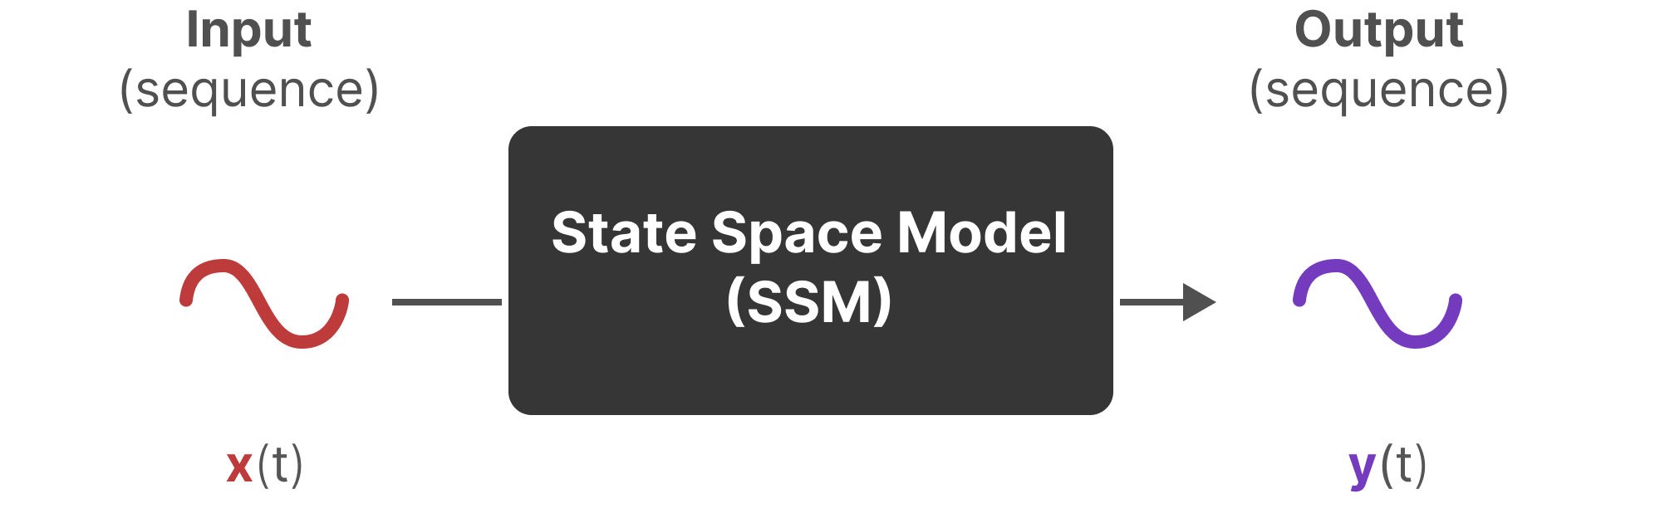
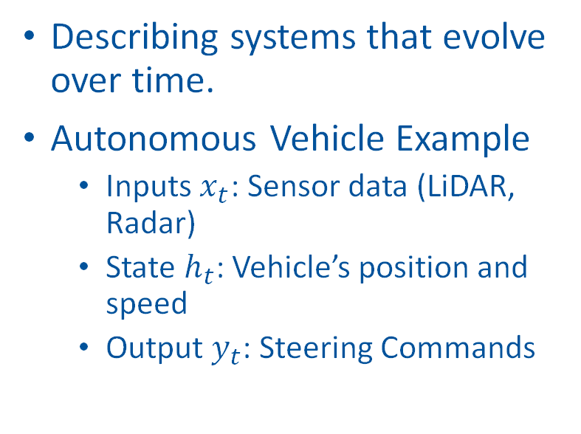
State Space Models (SSM)
Describing systems that evolve over time.
Autonomous Vehicle Example
Inputs $x_{t}$: Sensor data (LiDAR, Radar)
State $h_{t}$: Vehicle’s position and speed
Output $y_{t}$: Steering Commands
Image source: Maarten Grootendorst's Blog

Slide 4

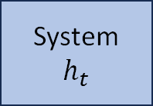
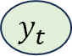
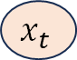
State Space Models (SSM)
Describing systems that evolve over time.
Autonomous Vehicle Example
Inputs $x_{t}$: Sensor data (LiDAR, Radar)
State $h_{t}$: Vehicle’s position and speed
Output $y_{t}$: Steering Commands
Input
Output
System
$$h_{t}$$
$$x_{t}$$
$$y_{t}$$

Slide 5
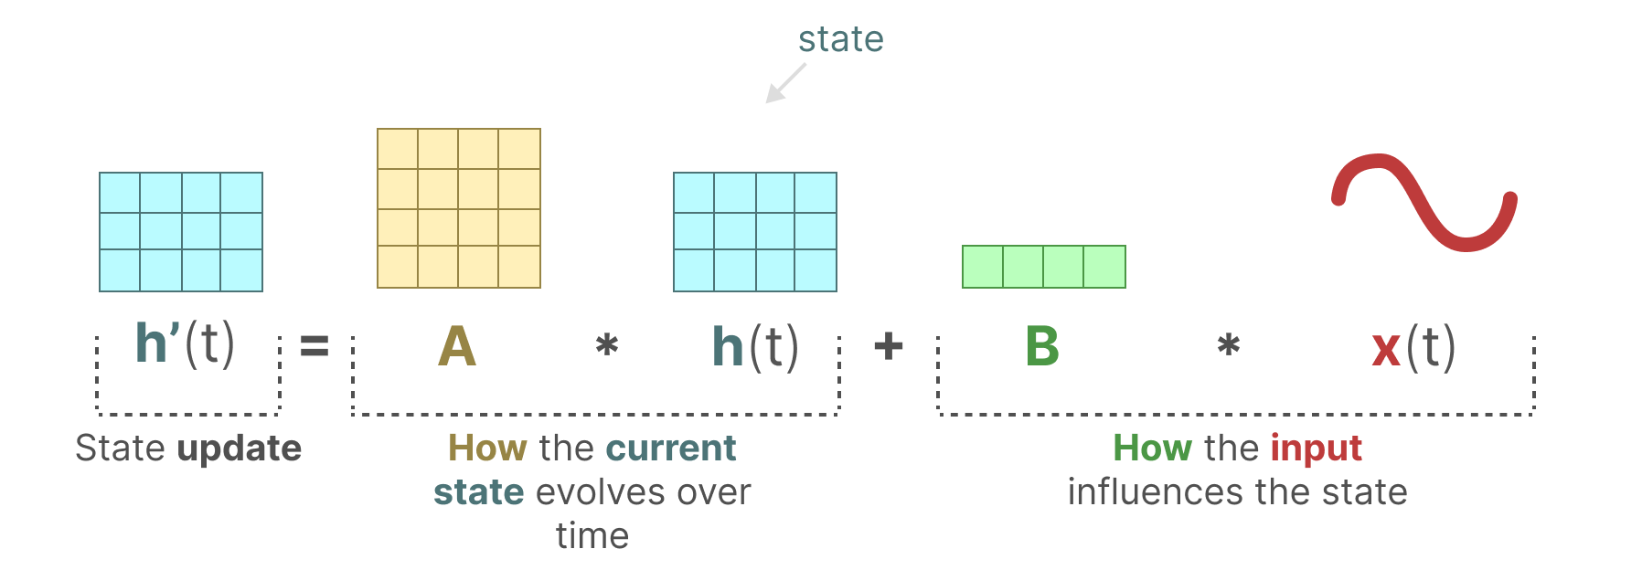
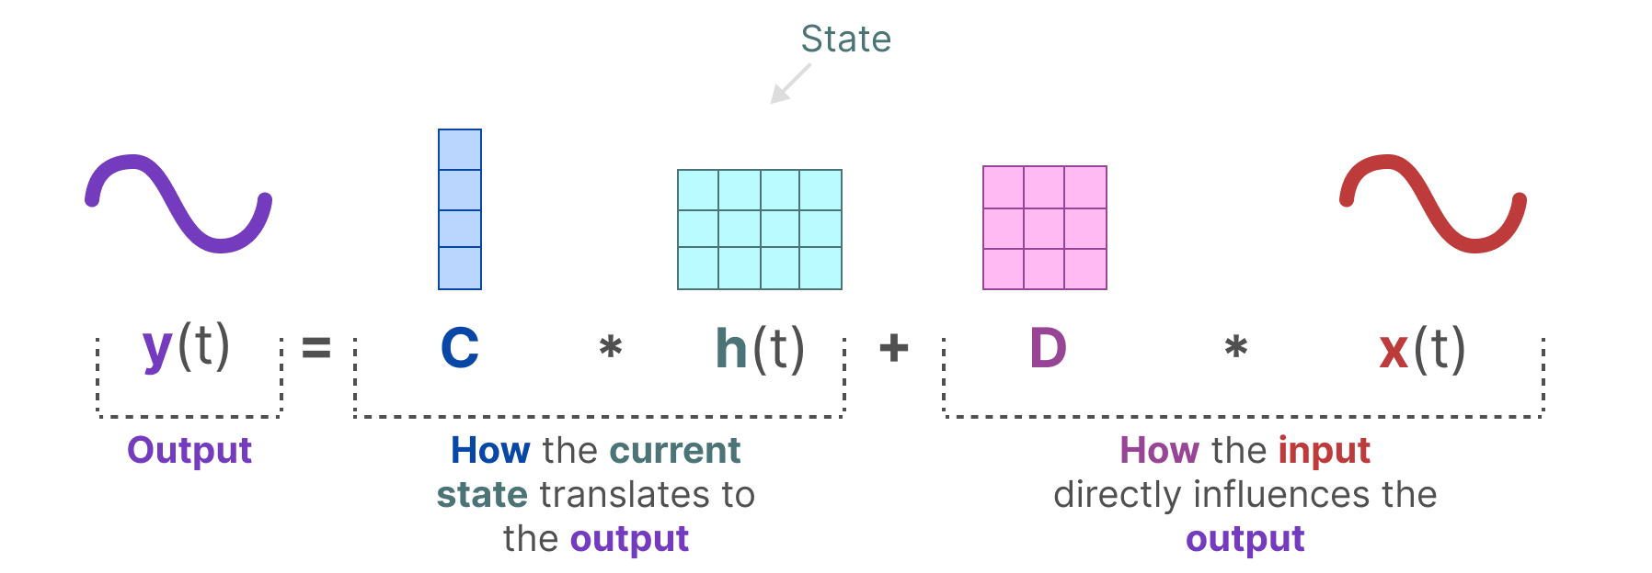
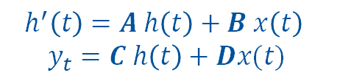
Equations (SSM like equations)
$$h^{′}\left(t\right)=A h\left(t\right)+B x\left(t\right)$$
$$y_{t}=C h\left(t\right)+Dx(t)$$
Image source: Maarten Grootendorst's Blog

Slide 6
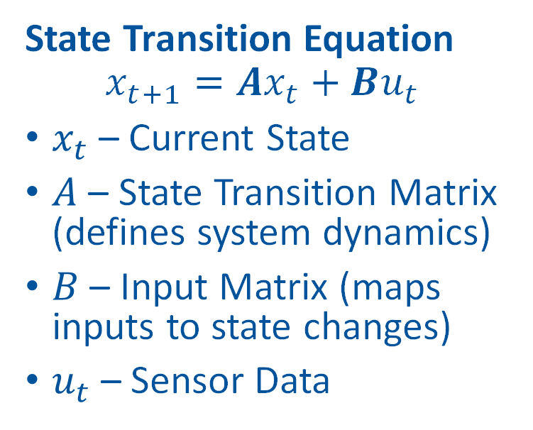
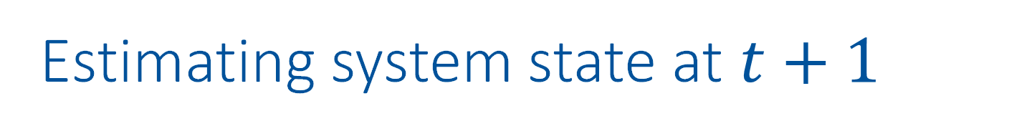
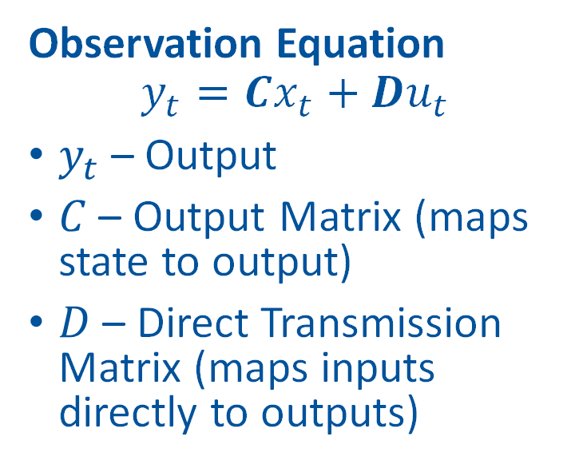
Estimating system state at $t+1$
Observation Equation
$$y_{t}=Cx_{t}+Du_{t}$$
$y_{t}$ – Output
$C$ – Output Matrix (maps state to output)
$D$ – Direct Transmission Matrix (maps inputs directly to outputs)
State Transition Equation
$$x_{t+1}=Ax_{t}+Bu_{t}$$
$x_{t}$ – Current State
$A$ – State Transition Matrix (defines system dynamics)
$B$ – Input Matrix (maps inputs to state changes)
$u_{t}$ – Sensor Data

Slide 7
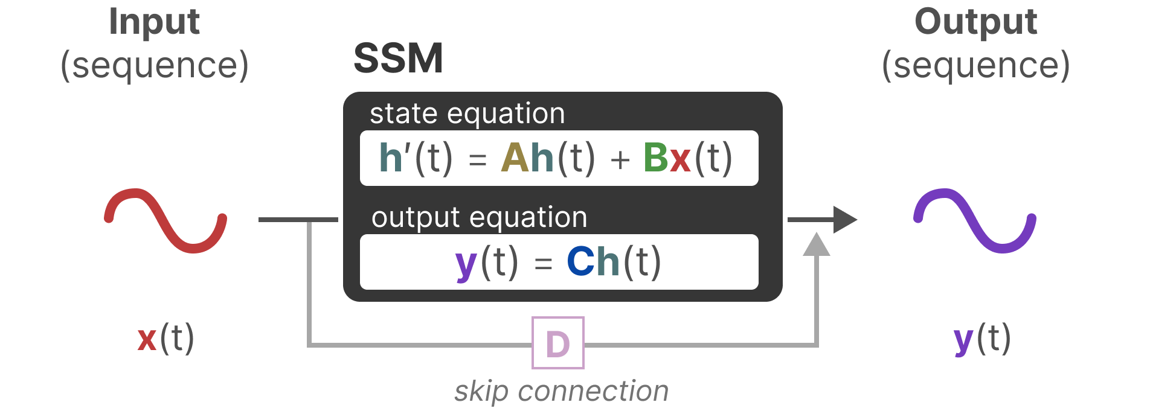

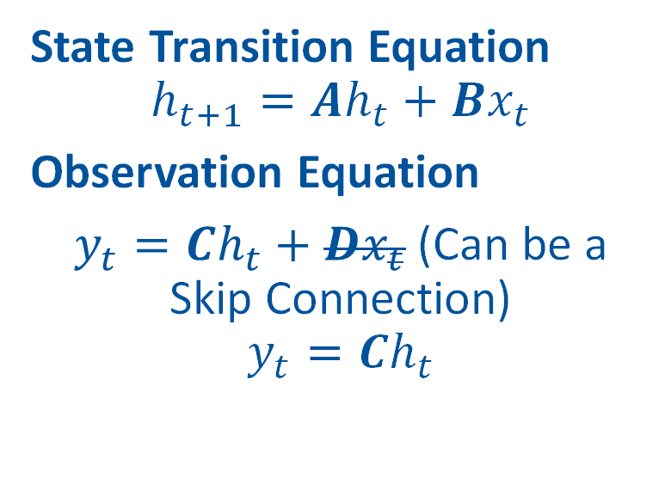
Final Equations
State Transition Equation
$$h_{t+1}=Ah_{t}+Bx_{t}$$
Observation Equation
$y_{t}=Ch_{t}+Dx_{t}$ (Can be a Skip Connection)
$$y_{t}=Ch_{t}$$
Image source: Maarten Grootendorst's Blog

Slide 8
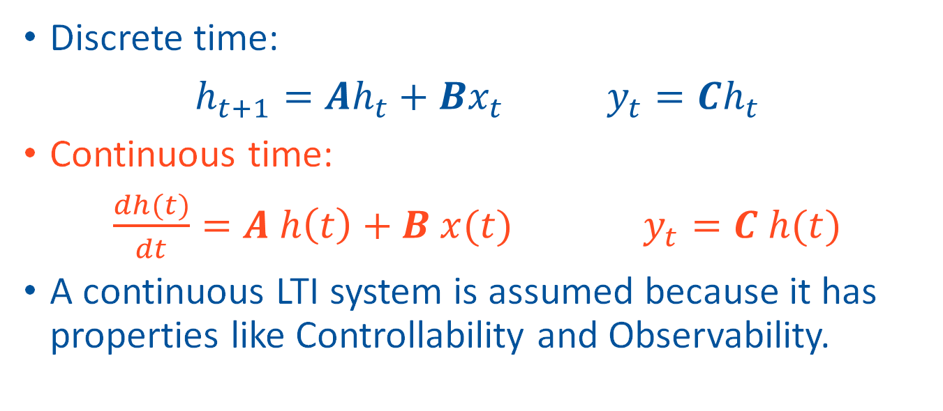
Continuous or Discrete Time?
Discrete time:
$h_{t+1}=Ah_{t}+Bx_{t}$ $y_{t}=Ch_{t}$
Continuous time:
$\frac{dh(t)}{dt}=A h\left(t\right)+B x(t)$ $y_{t}=C h(t)$
A continuous LTI system is assumed because it has properties like Controllability and Observability.
Notes:
SSMs can be described using discrete equations directly, but models use continuous time and then discretize them

Slide 9
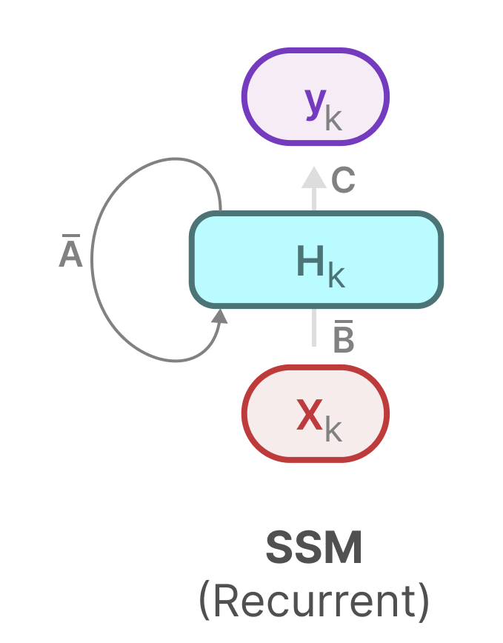
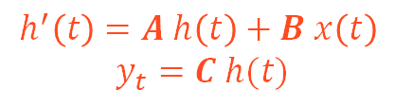
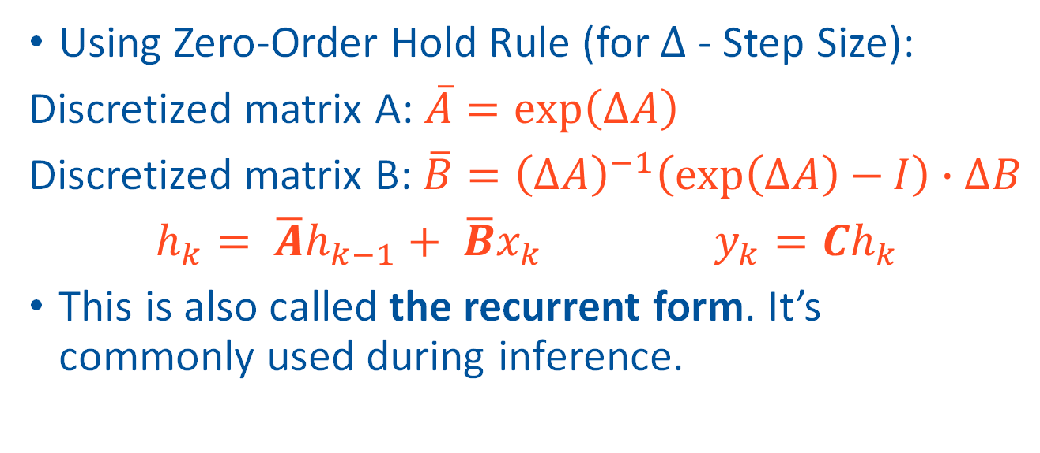
Discretization (Recurrent SSM)
$$h^{′}\left(t\right)=A h\left(t\right)+B x\left(t\right)$$
$$y_{t}=C h(t)$$
Using Zero-Order Hold Rule (for $∆$ - Step Size):
Discretized matrix A: $\overline{A}=\exp\left(∆A\right)$
Discretized matrix B:$\overline{B}={\left(∆A\right)}^{−1}\left(\exp\left(∆A\right)−I\right)∙∆B$
$h_{k}= \overline{A}h_{k−1}+ \overline{B}x_{k}$ $y_{k}=Ch_{k}$
This is also called the recurrent form. It’s commonly used during inference.
Image source: Maarten Grootendorst's Blog
Notes:
To be applied on discrete inputs continuous-time SSM is discretized.
There are many methods to do this.
This form is only used during inference when we see one timestep at a time.

Slide 10
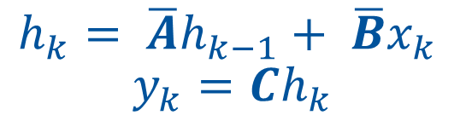
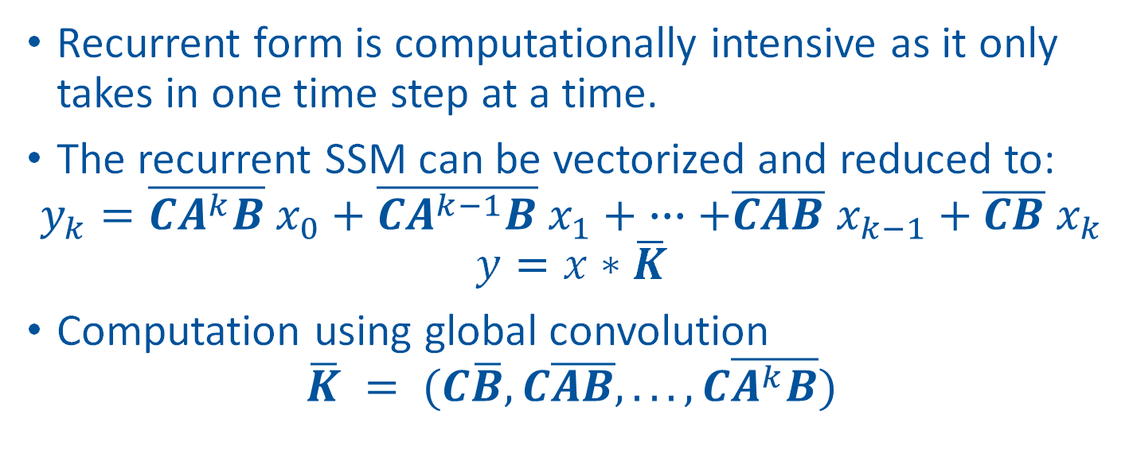
Convolution Form
$h_{k}= \overline{A}h_{k−1}+ \overline{B}x_{k}$ $y_{k}=Ch_{k}$
Recurrent form is computationally intensive as it only takes in one time step at a time.
The recurrent SSM can be vectorized and reduced to:
$$y_{k}=\overline{CA^{k}B} x_{0}+\overline{CA^{k−1}B} x_{1}+ ∙∙∙+\overline{CAB} x_{k−1}+\overline{CB} x_{k}$$
$$y=x∗\overline{K}$$
Computation using global convolution
$$\overline{K} = (C\overline{B}, C\overline{AB}, . . . , C\overline{A^{k}B})$$

Slide 11
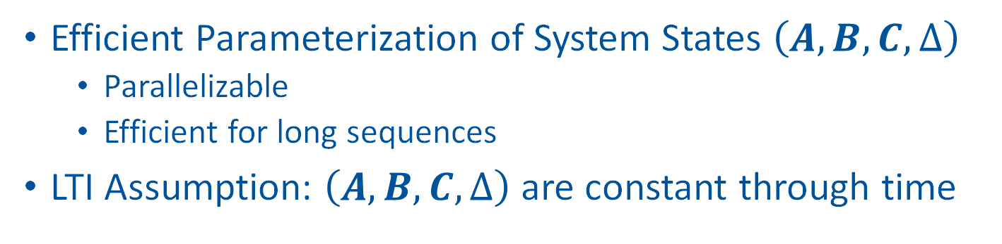
S4 Paper Contribution
Efficient Parameterization of System States $\left(A,B, C, ∆\right)$
Parallelizable
Efficient for long sequences
LTI Assumption: $\left(A,B, C, ∆\right)$ are constant through time

Slide 12
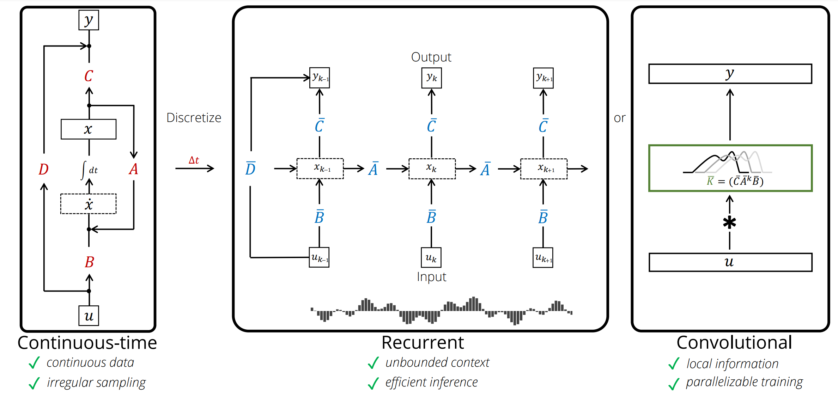
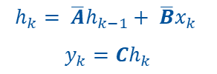
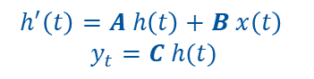

3 views of SSM
$$h^{′}\left(t\right)=A h\left(t\right)+B x\left(t\right)$$
$$y_{t}=C h(t)$$
$h_{k}= \overline{A}h_{k−1}+ \overline{B}x_{k}$
$y_{k}=Ch_{k}$
$$y=x∗\overline{K}$$

Slide 13
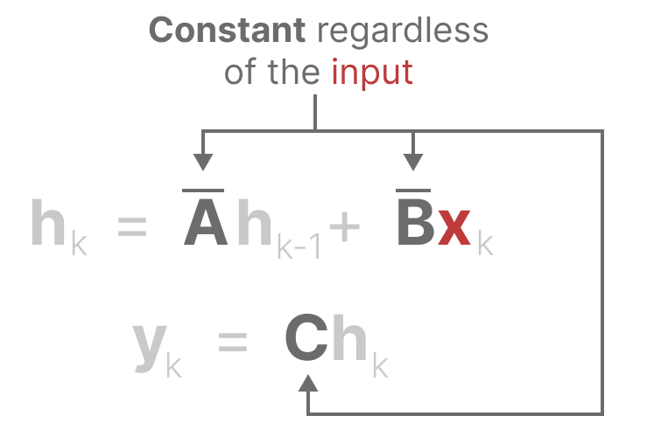
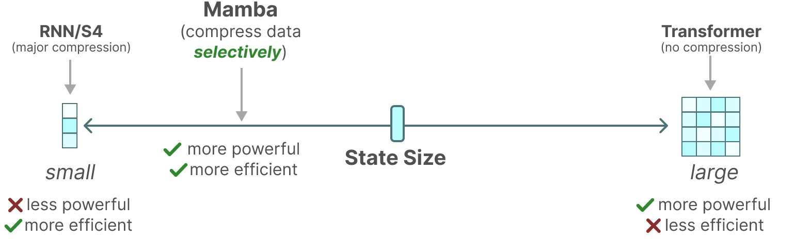
Why Mamba?
S4 models use fixed states (High compression)
Cannot be applied to discrete modalities like language
Image source: Maarten Grootendorst's Blog

Slide 14
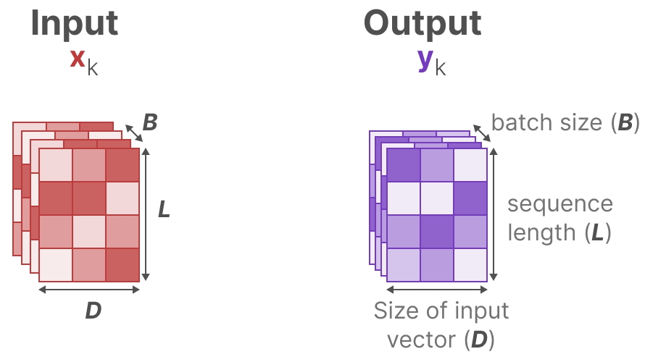
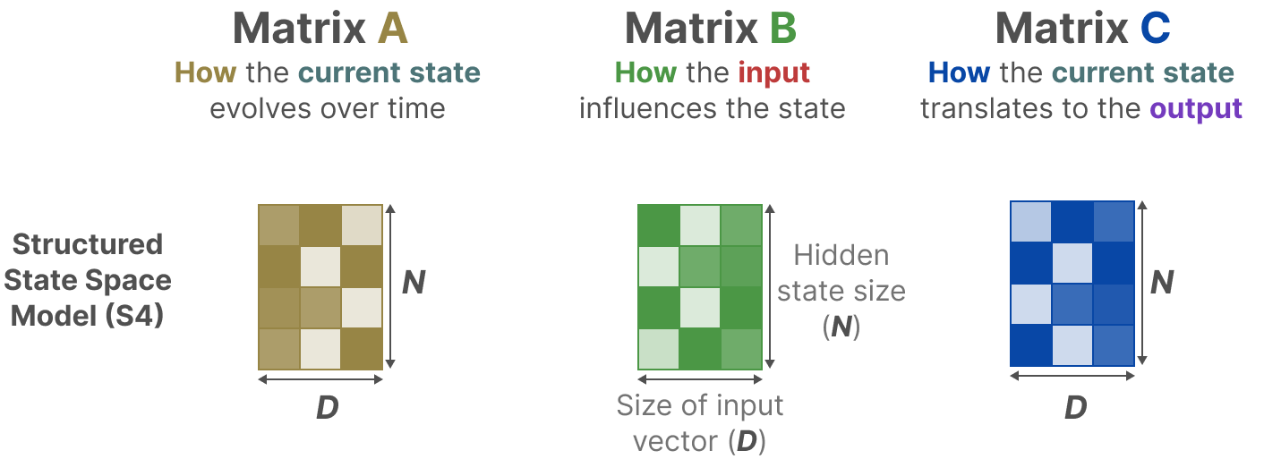
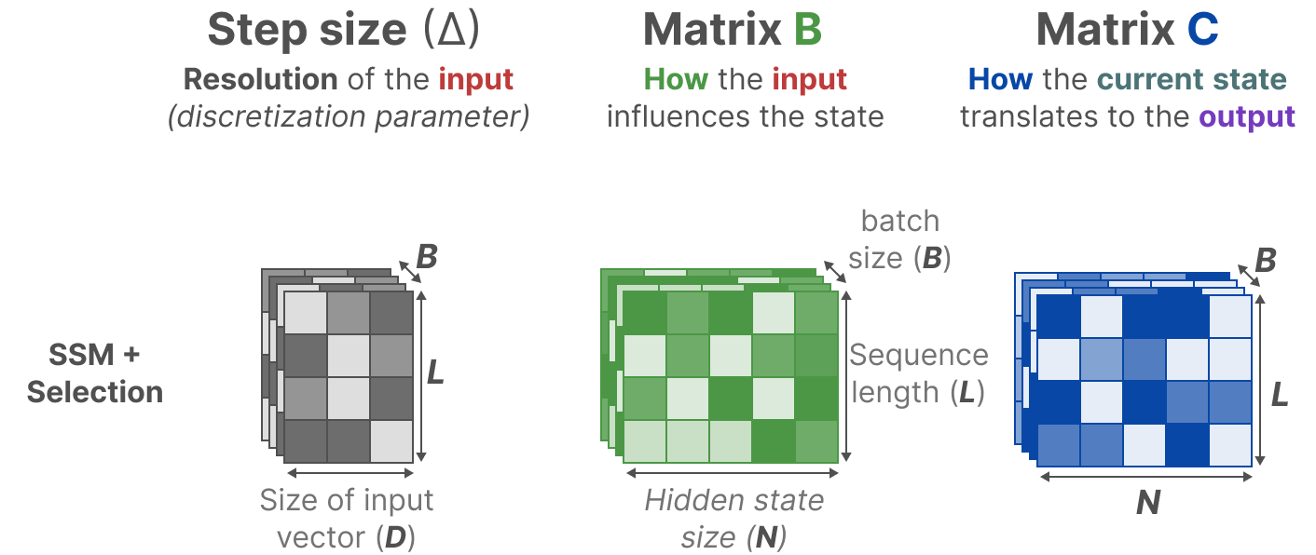
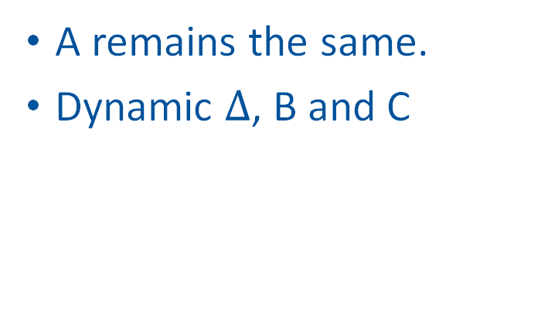
S4 vs Mamba
S4
Mamba
A, B and C remain the same for all inputs.
A remains the same.
Dynamic $∆$, B and C
Image source: Maarten Grootendorst's Blog

Slide 15
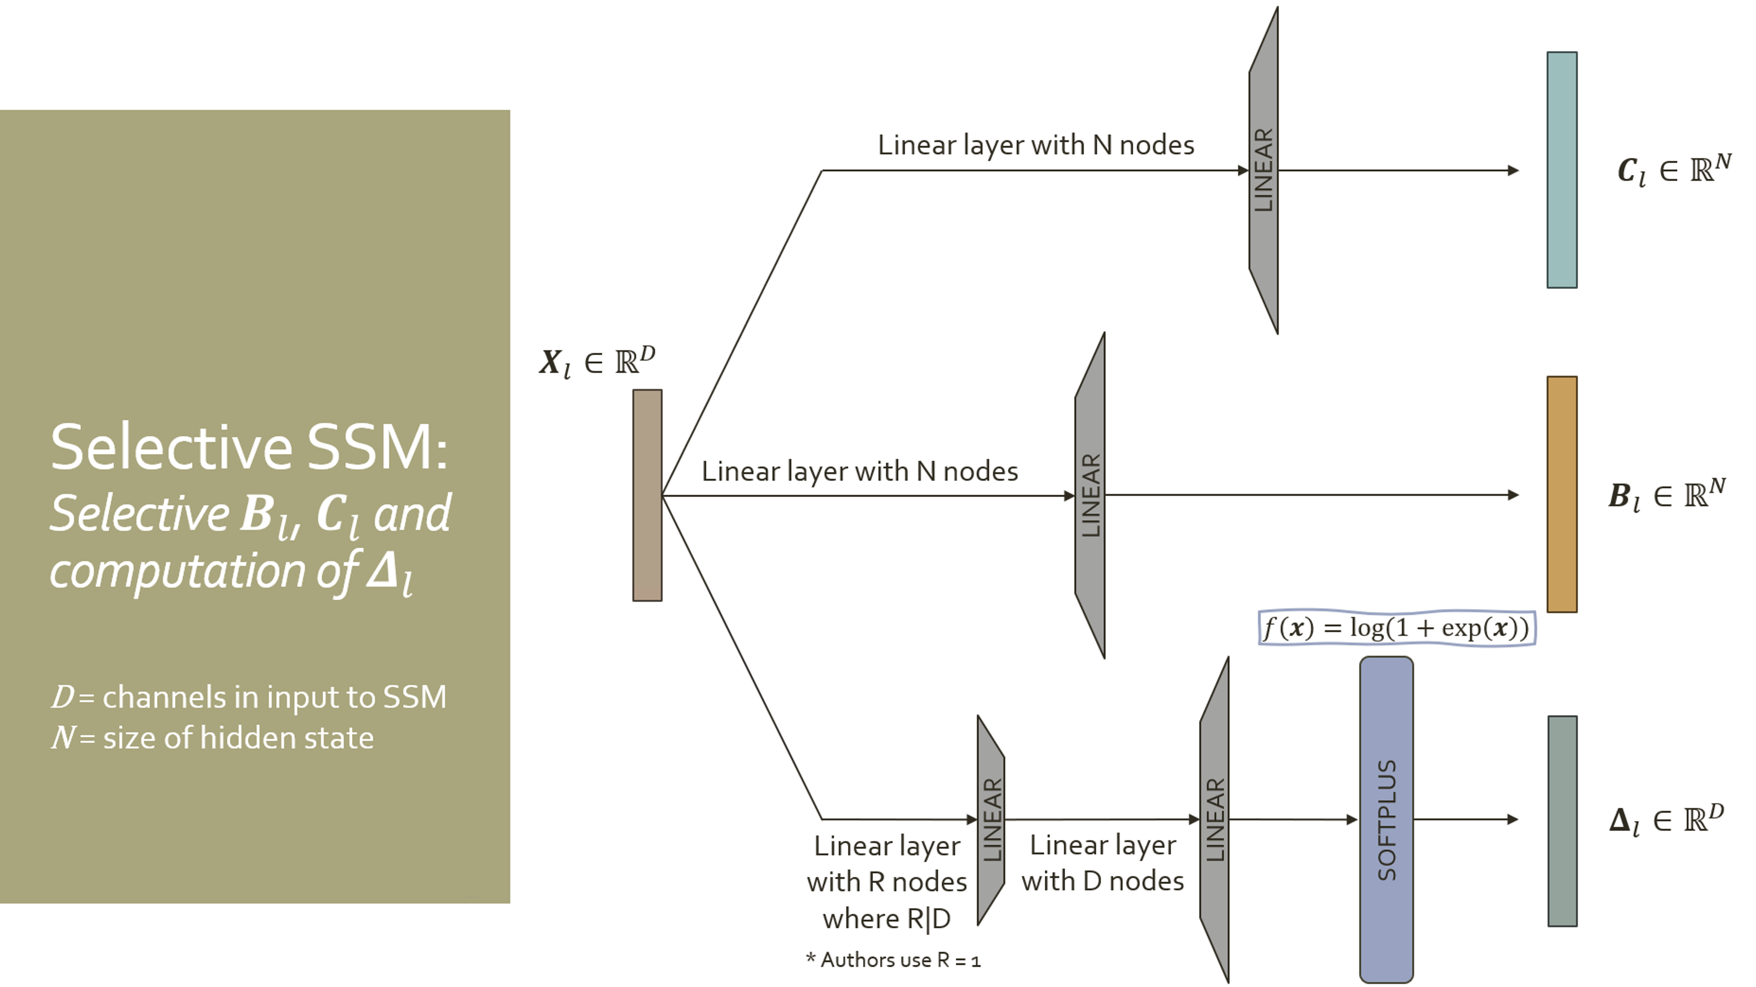
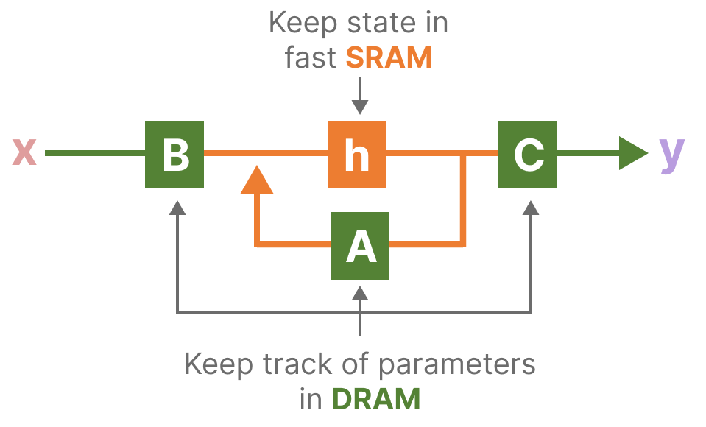
Mamba Contribution
Selective scan algorithm (using linear layers)
Hardware-aware algorithm (use GPU SRAM and DRAM selectively)
Image source: Anna_Isaly Slides and Maarten Grootendorst's Blog

Slide 16
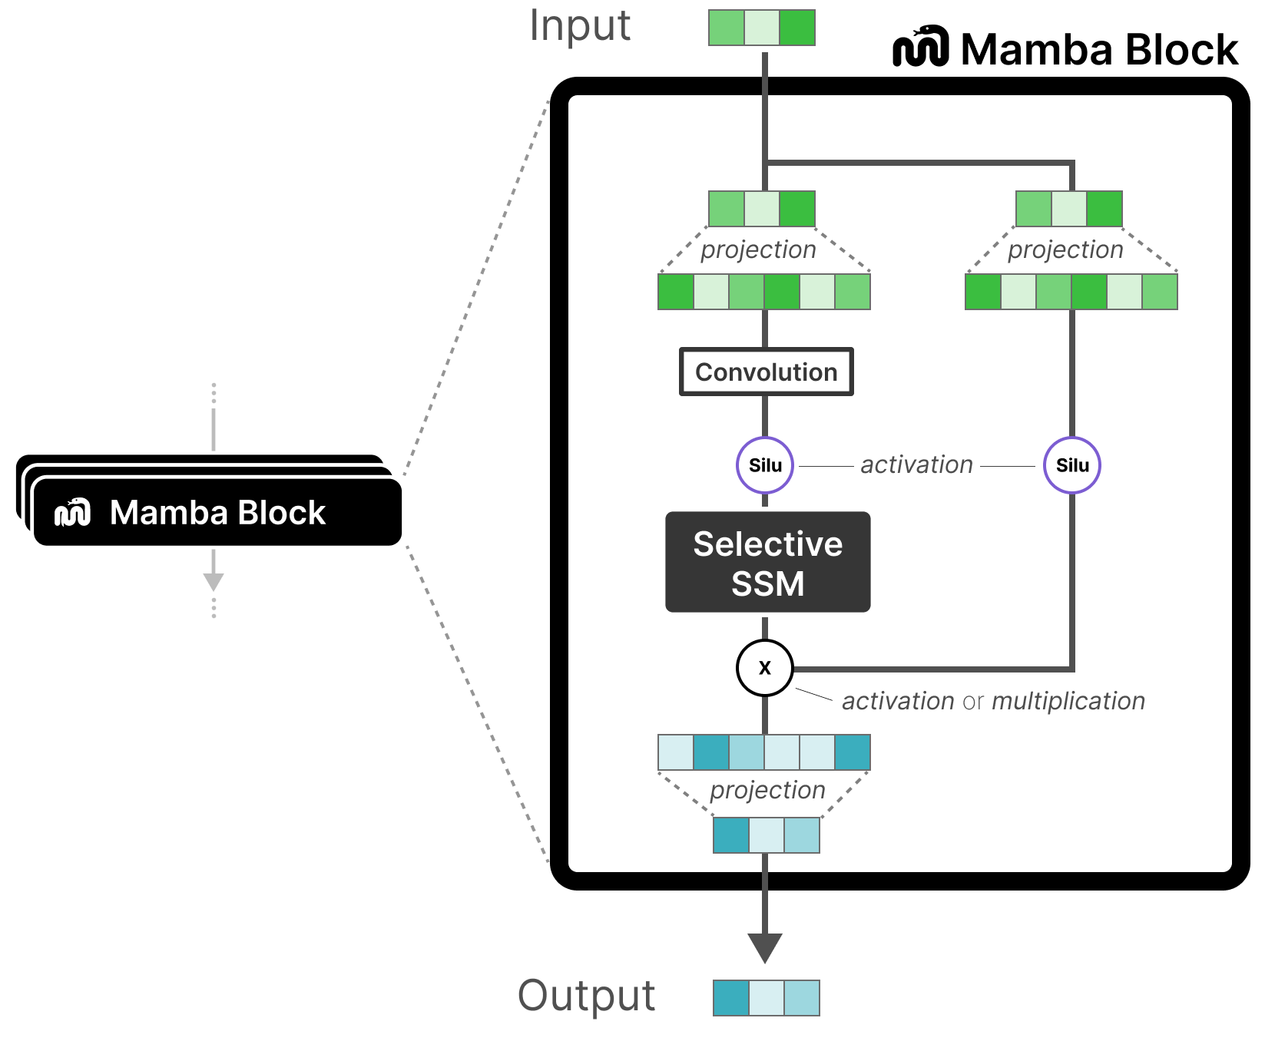
Mamba Block
Projection: Linear layer
Selective SSM does the following:
Discretization and HiPPO initialization (S4)
Selective scan algorithm to selectively compress information (Mamba)
Hardware-aware algorithm to speed up computation (Mamba)

Slide 17
Remote Sensing Motivation (Mamba Limitations)

Slide 18
Motivation (for Remote Sensing)
Tasks like image classification require
global feature modeling (which Mamba does well)
using spatial relationships (Mamba lacks)
Mamba is:
restricted to modeling causal sequences
insensitive to the spatial position

Slide 19
RSMamba Contribution
Multipath Activation Mechanism
Create multiple path copies of the input, namely, forward, reverse and shuffle
Instead of modifying Mamba block, they leverage linear mapping across different paths

Slide 20
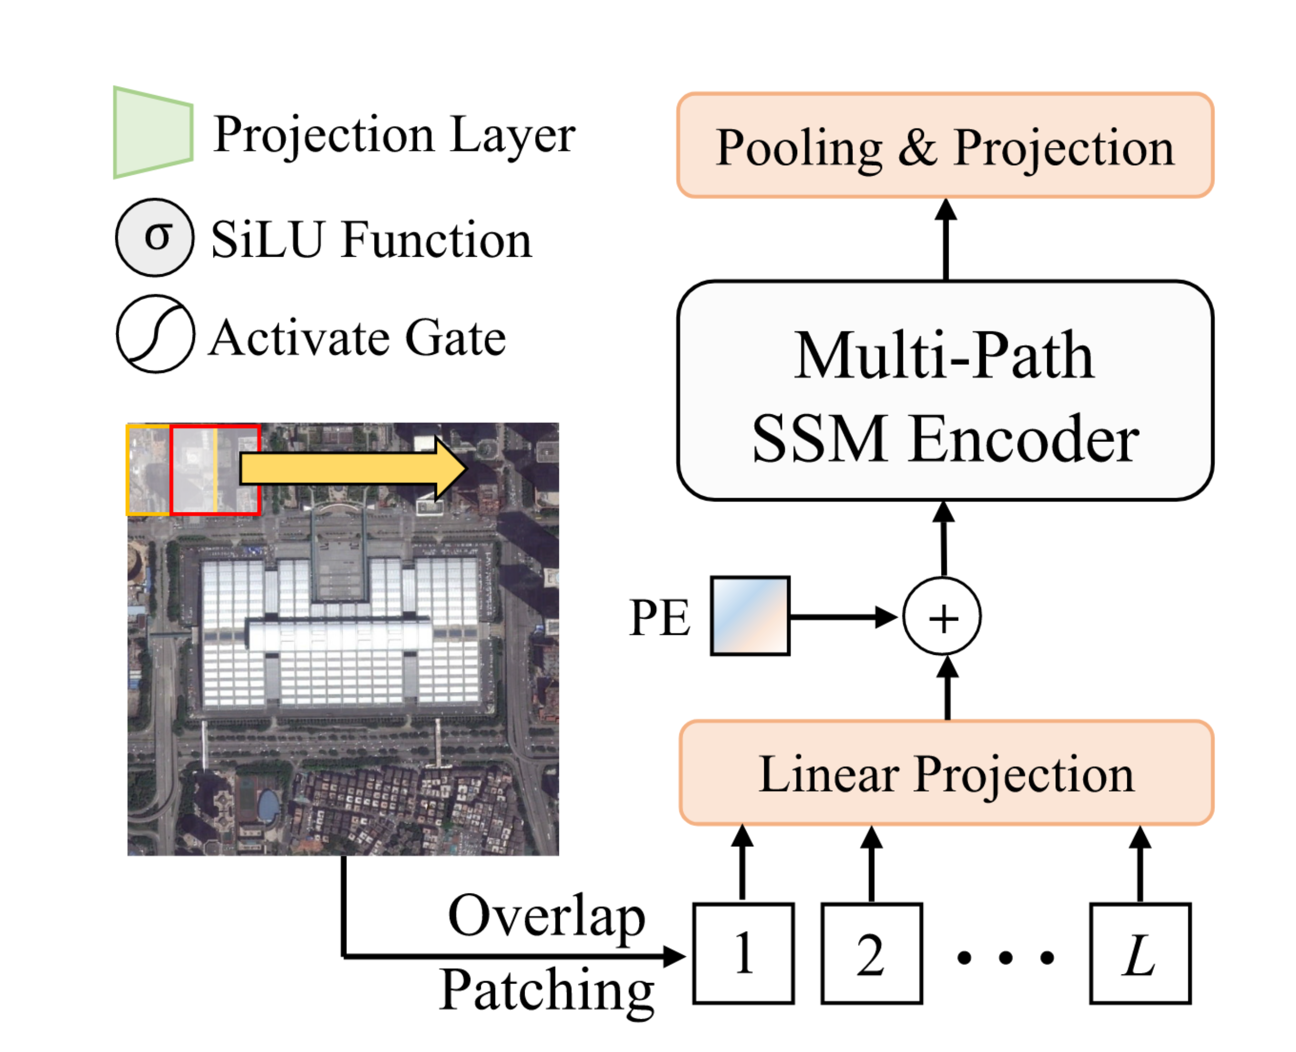
RS-Mamba Architecture Overview
ViT like patching and Positional Encoding (PE)
Projects the features to number of classes
2D Conv Layer +
Flattening

Slide 21
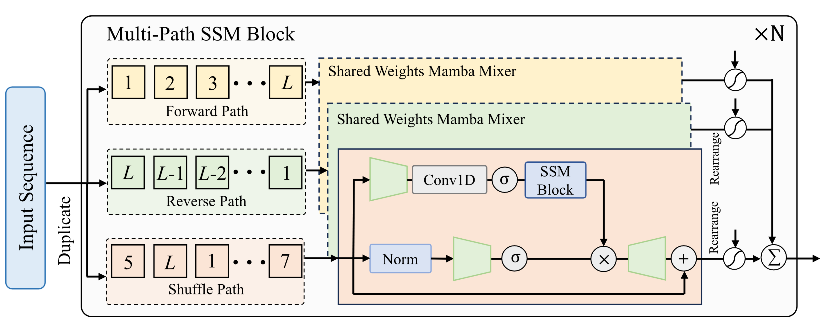
Multi-Path SSM Block

Slide 22
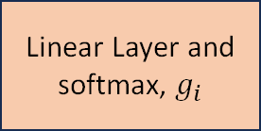
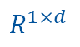
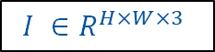
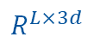

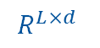
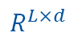
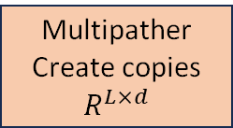
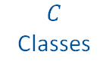
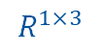

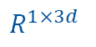
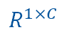
RSMamba Flow
L – Sequence len
d – Latent dim
$$×N$$
Reverse Path
Conv2d,
Flattening,
Positional Encoding
Reverse Multipather, Concat along features
$$R^{L×d}$$
Multipather
Create copies
$$R^{L×d}$$
Forward
Path
Mamba
Block
$$R^{L×d}$$
$$I ∈R^{H×W×3}$$
All
3
Paths
Shuffle Path
Linear Layer and softmax, $g_{i}$
Mean
Pooling along L
$$R^{L×3d}$$
$$R^{1×3}$$
$$R^{1×3d}$$
$$R^{1×C}$$
$$R^{1×d}$$
Global Average Pooling
$$R^{L×d}$$
FC Layer
$C$ Classes
Notes:
for final classification a Global Avg Pooling and a FC layer is used

Slide 23
RSMamba Flow
L – Sequence len
d – Latent dim
$$×N$$
Reverse Path
Conv2d,
Flattening,
Positional Encoding
Reverse Multipather, Concat along features
$$R^{L×d}$$
Multipather
Create copies
$$R^{L×d}$$
Forward
Path
Mamba
Block
$$R^{L×d}$$
$$I ∈R^{H×W×3}$$
All
3
Paths
Shuffle Path
Linear Layer and softmax, $g_{i}$
Mean
Pooling along L
$$R^{L×3d}$$
$$R^{1×3}$$
$$R^{1×3d}$$
$$R^{1×C}$$
$$R^{1×d}$$
Global Average Pooling
$$R^{L×d}$$
FC Layer
$C$ Classes
Notes:
for final classification a Global Avg Pooling and a FC layer is used

Slide 24
Dataset Description
Dataset Name | Number of Categories | Total Images | Image Resolution | Spatial Resolution | Training Data Proportion
UC Merced Land-Use | 21 | 2100 | 256 × 256 pixels | 0.3 m per pixel | 70% (100 images per category)
AID: Aerial Images Dataset | 30 | 10,000 | 600 × 600 pixels | 8 m to 0.5 m per pixel | 50%
NWPU-RESISC45 | 45 | 31,500 | 256 × 256 pixels | 30 m to 0.2 m per pixel | 70%
Input Image size-(224 x 224) |Data Augmentation Techniques: Random Clipping, Flipping, Mixup, |
| Processing: Images are transformed into sequential data for model input-kernel size=16, stride=8 | Training Duration: 500 Epochs |Performance Metrics : Precision(P), Recall (R) and F1-Score | Batch Size : 1024| Optimizer : AdamW
Notes:
NWPU-RESISC45-REmote Sensing Image Scene Classification (RESISC), created by Northwestern Polytechnical University (NWPU)., 45 scene classes.

Slide 25
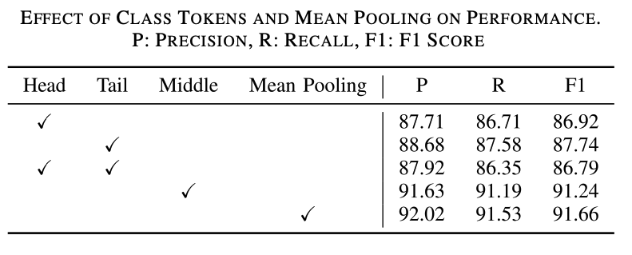
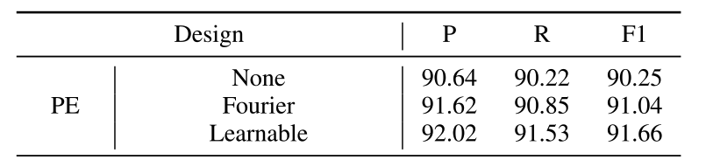
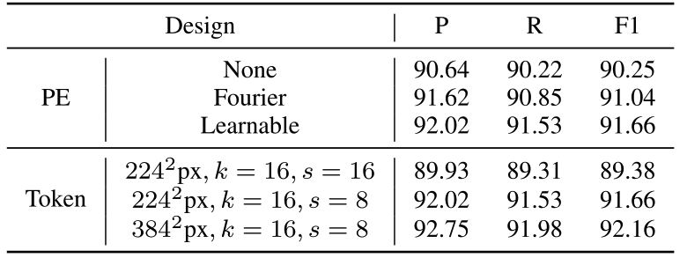
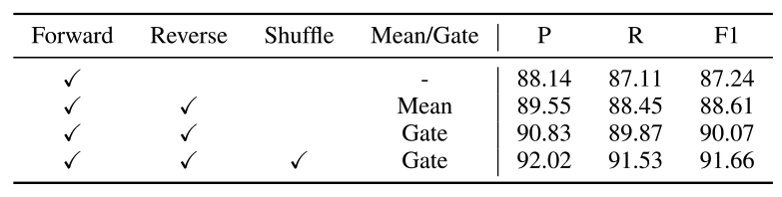
Ablation Study
EFFECT OF POSITIONAL ENCODING AND NUMBER OF TOKENS
EFFECT OF CLASS TOKENS AND MEAN POOLING
EFFECT OF POSITIONAL ENCODING
EFFECT OF MULTIPLE SCANNING PATHS
Notes:
Ablation Study:
Class Tokens: Avg Pooilng is tend to do better than Class tokens
If Image I has N patches , embedding --> [Class Token, Patch 1, Patch 2, ..., Patch N]: Head token
After Mamba mixer, (B,T+1,D)--> self attention layers--> class token feature vector is extracted --> (B,D)
Vs Mean Pooling: (B,T,D) to (B,D) after mean pooling.
2. Positional Encoding : Not that effective in RS Mamba :
The RSMamba model incorporates a dynamic multi-path activation mechanism, which is a key feature that enhances its ability to process image patches (tokens). This mechanism involves creating multiple copies of the input sequence and processing them through different paths—specifically, forward, reverse, and random paths. This approach allows RSMamba to capture diverse relationships among the tokens while maintaining their spatial context.
An important aspect of this mechanism is its ability to restore the original order of the tokens after processing. This capability mitigates the reliance on positional encoding, which is typically used to provide information about the position of each token in a sequence. As a result, RSMamba can perform effectively even if positional encoding is not optimally implemented or is absent, thanks to its design that preserves the contextual relationships among tokens. Overall, the dynamic multi-path activation mechanism contributes significantly to RSMamba's robustness and flexibility in handling visual data, making it a powerful tool for remote sensing image classification and other related tasks.
3. Number of Tokens: Stride (Less, more overlap), better resolution can lead to better results
4. Effect of Multiple Scanning Paths:
Causal Sequence Limitation: The vanilla Mamba struggles with two-dimensional image data due to its focus on causal sequences.
Three Scanning Paths: RSMamba introduces:
Forward Path
Reverse Path
Random Shuffling Path This diversity allows for better information capture.
Adaptive Activation: Instead of averaging, RSMamba uses a gating mechanism to selectively integrate information from the different paths.
Performance Enhancement: The use of multiple scanning paths leads to significant improvements in classification performance compared to traditional methods.
4. Gating : Output from all scanning directions, what proportion of each goes to the final output? Typically weighted sum

Slide 26
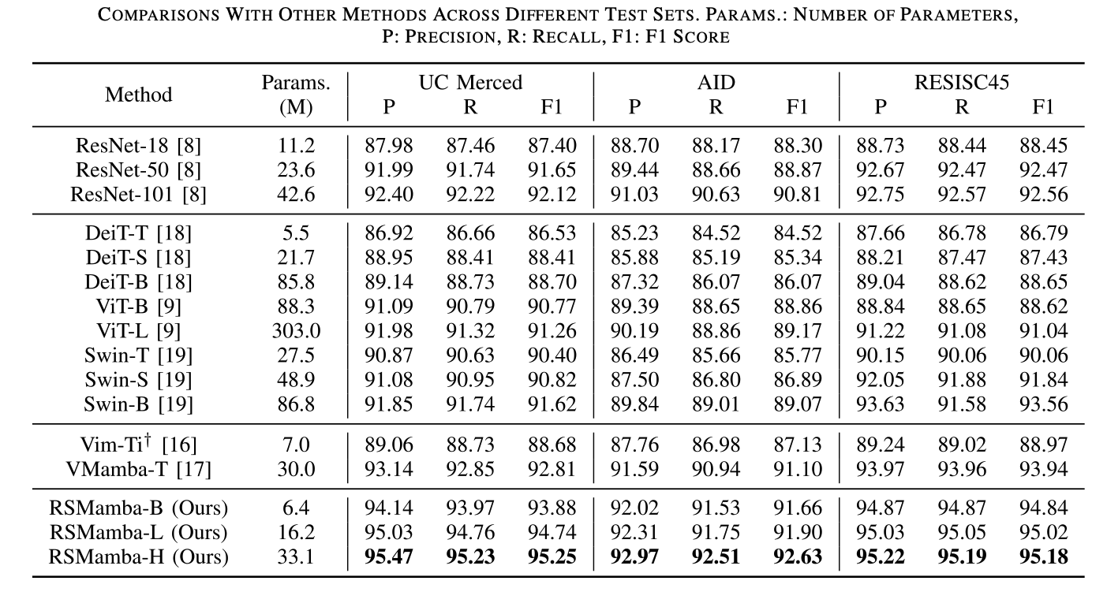
RS Mamba Performance Comparison

Slide 27
RS Mamba Performance Comparison
Advantages:
Performs well across various dataset sizes— requires relatively less parameters to train
2. Scalability: Increase of depth and width increases performance.
3. “Dynamic Path Scanning” is effective as it performs better than Mamba based Vim and VMamba
Disadvantages:
1. Takes more time to train

Slide 28
References
Gu, A., Goel, K., & Ré, C. (2021). Efficiently modeling long sequences with structured state spaces. arXiv preprint arXiv:2111.00396.
Gu, A., Dao, T., Ermon, S., Rudra, A., & Ré, C. (2020). Hippo: Recurrent memory with optimal polynomial projections. Advances in neural information processing systems, 33, 1474-1487.
Gu, A., Johnson, I., Goel, K., Saab, K., Dao, T., Rudra, A., & Ré, C. (2021). Combining recurrent, convolutional, and continuous-time models with linear state space layers. Advances in neural information processing systems, 34, 572-585.
Tri Dao, Daniel Y Fu, Khaled K Saab, Armin W Thomas, Atri Rudra, and Christopher Ré. “Hungry Hungry Hippos: Towards Language Modeling with State Space Models”. In: The International Conference on Learning Representations (ICLR). 2023.
Gu, A., & Dao, T. (2023). Mamba: Linear-time sequence modeling with selective state spaces. arXiv preprint arXiv:2312.00752.
Chen, K., Chen, B., Liu, C., Li, W., Zou, Z., & Shi, Z. (2024). Rsmamba: Remote sensing image classification with state space model. IEEE Geoscience and Remote Sensing Letters.

